Slide 1
MEDICAL THESIS
Here is where your presentation begins

Slide 2
CONTENTS OF THIS TEMPLATE
Here’s what you’ll find in this Slidesgo template:
A slide structure based on a Master’s Thesis, which you can easily adapt to your needs. For more info on how to edit the template, please visit Slidesgo School or read our FAQs.
A thanks slide, which you must keep so that proper credits for our design are given.
A resources slide, where you’ll find links to all the elements used in the template.
Instructions for use.
Final slides with:
The fonts and colors used in the template.
More infographic resources, whose size and color can be edited.
Sets of customizable icons of the following themes: general, business, avatar, creative process, education, help & support, medical, nature, performing arts, SEO & marketing, and teamwork.
You can delete this slide when you’re done editing the presentation.

Slide 3
01 OBJECTIVES
03 RESULTS ANALYSIS
TABLE OF CONTENTS
02 METHODOLOGY
04 CONCLUSIONS
Here you could describe the topic of the section
Here you could describe the topic of the section
Here you could describe the topic of the section
Here you could describe the topic of the section

Slide 4
INTRODUCTION
Mercury is the closest planet to the Sun and the smallest one in the Solar System—it’s only a bit larger than our Moon. The planet’s name has nothing to do with the liquid metal since it was named after the Roman messenger god, Mercury

Slide 5
—SOMEONE FAMOUS
“This is a quote. Words full of wisdom that someone important said and can make the reader get inspired.”

Slide 6
01 SECTION
Here you could describe the topic of the section

Slide 7
STUDY OBJECTIVES
MERCURY
MARS
VENUS
Despite being red, Mars is a cold place, not hot. It’s full of iron oxide dust, which gives the planet its reddish cast
Mercury is the closest planet to the Sun and the smallest one in the Solar System—a bit larger than our Moon
Venus has a beautiful name and is the second planet from the Sun. Its atmosphere is extremely poisonous

Slide 8
01
Theory
02
Theory
LITERATURE REVIEW
03
Theory
04
Theory
Neptune is the farthest planet in our Solar System. It’s the fourth-largest by diameter and the densest
Venus has a beautiful name and is the second planet from the Sun. It’s terribly hot, even hotter than Mercury
Mercury is the closest planet to the Sun and the smallest one in the Solar System—it’s only a bit larger than our Moon
Despite being red, Mars is a cold place, not hot. It’s full of iron oxide dust, which gives the planet its reddish cast

Slide 9
AWESOME WORDS

Slide 10
SCHEDULE
26
27
28
29
30
31
1
WEEK 1
2
3
4
5
6
7
8
WEEK 2
9
10
11
12
13
14
15
WEEK 3
16
17
18
19
20
21
22
WEEK 4
23
24
25
26
27
28
29
WEEK 5

Slide 11
METHODOLOGY
JUPITER
Jupiter is the biggest planet in our Solar System and also the fourth-brightest object in the sky
VENUS
SATURN
Venus has a beautiful name and is the second planet from the Sun. It’s terribly hot
Saturn is a gas giant, composed mostly of hydrogen and helium

Slide 12
TEST
TEST 1
TEST 2
TEST 3
TEST 4
TEST 5
Describe here your metrics 1
Describe here your metrics 2
Describe here your metrics 3
Describe here your metrics 4

Slide 13
RESULTS ANALYSIS
30,000
2,000
Sample size
Cases that need further research
If you want to modify this graph, click on it, follow the link, change the data and replace it
If you want to modify this graph, click on it, follow the link, change the data and replace it

Slide 14
1,520
5,000
RESULTS ANALYSIS
3,250
Saturn is a gas giant, composed mostly of hydrogen and helium
Jupiter is the biggest planet in our Solar System
Neptune is the farthest planet from the Sun

Slide 15
01
CONCLUSION
02
CONCLUSION
CONCLUSIONS
Jupiter is a gas giant and the biggest planet in our Solar System. It’s also the fourth-brightest object in the sky, and its name comes from the Roman god of the sky and lightning
Mercury is the closest planet to the Sun and the smallest one in the Solar System—it’s only a bit larger than our Moon. The planet’s name has nothing to do with the liquid metal

Slide 16
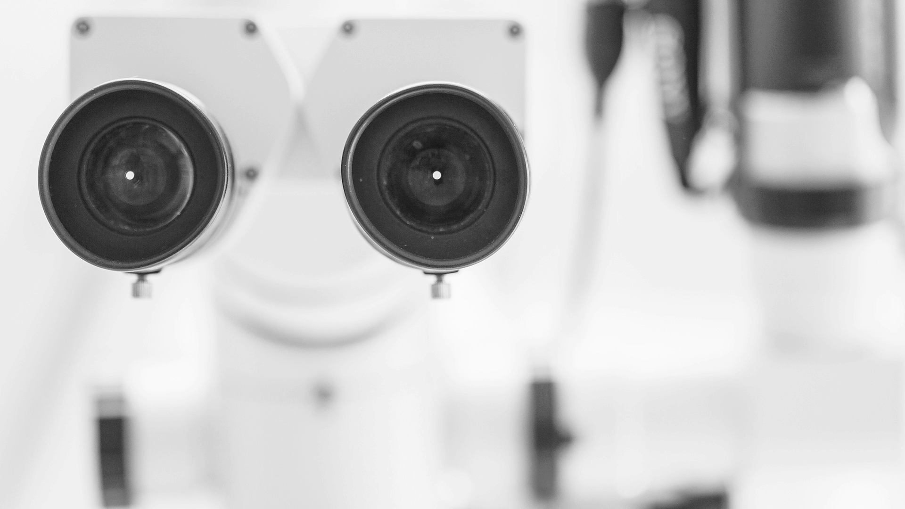
03
CONCLUSION
CONCLUSIONS
To replace the image, just select it and click Replace image. After that, we suggest that you adjust it to fit the style of this template. To do so, select the image, click Format options, open the Recolor drop-down menu and choose Grayscale

Slide 17
BIBLIOGRAPHY
AUTHOR | Year | Title of the publication. Publisher
AUTHOR | Year | Title of the publication. Publisher
AUTHOR | Year | Title of the publication. Publisher
AUTHOR | Year | Title of the publication. Publisher
AUTHOR | Year | Title of the publication. Publisher

Slide 18
THANKS
Does anyone have any questions?
addyouremail@freepik.com
+91 620 421 838
yourcompany.com

Slide 19
RESOURCES
ICONS
Biology
VECTORS
Abstract dna background
Abstract dna background
Abstract dna background
PHOTOS
Close-up of a dental microscope

