Slide 1
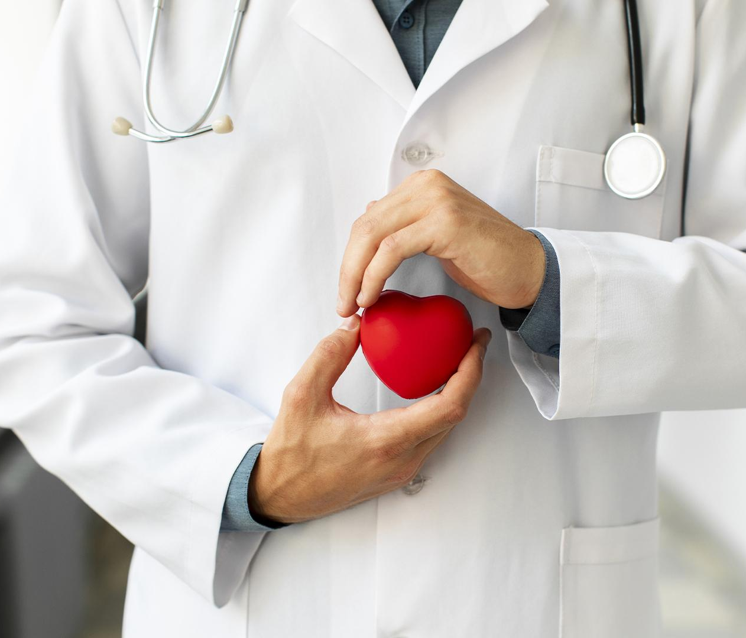
CARDIOLOGY CASE STUDY

Slide 2
CONTENTS OF THIS TEMPLATE

Slide 3
02
04
Discussion
Treatment
CONTENTS
01
03
05
About the Patient
Diagnosis
Monitoring

Slide 4
01
ABOUT US
You could enter a subtitle here if you need it

Slide 5
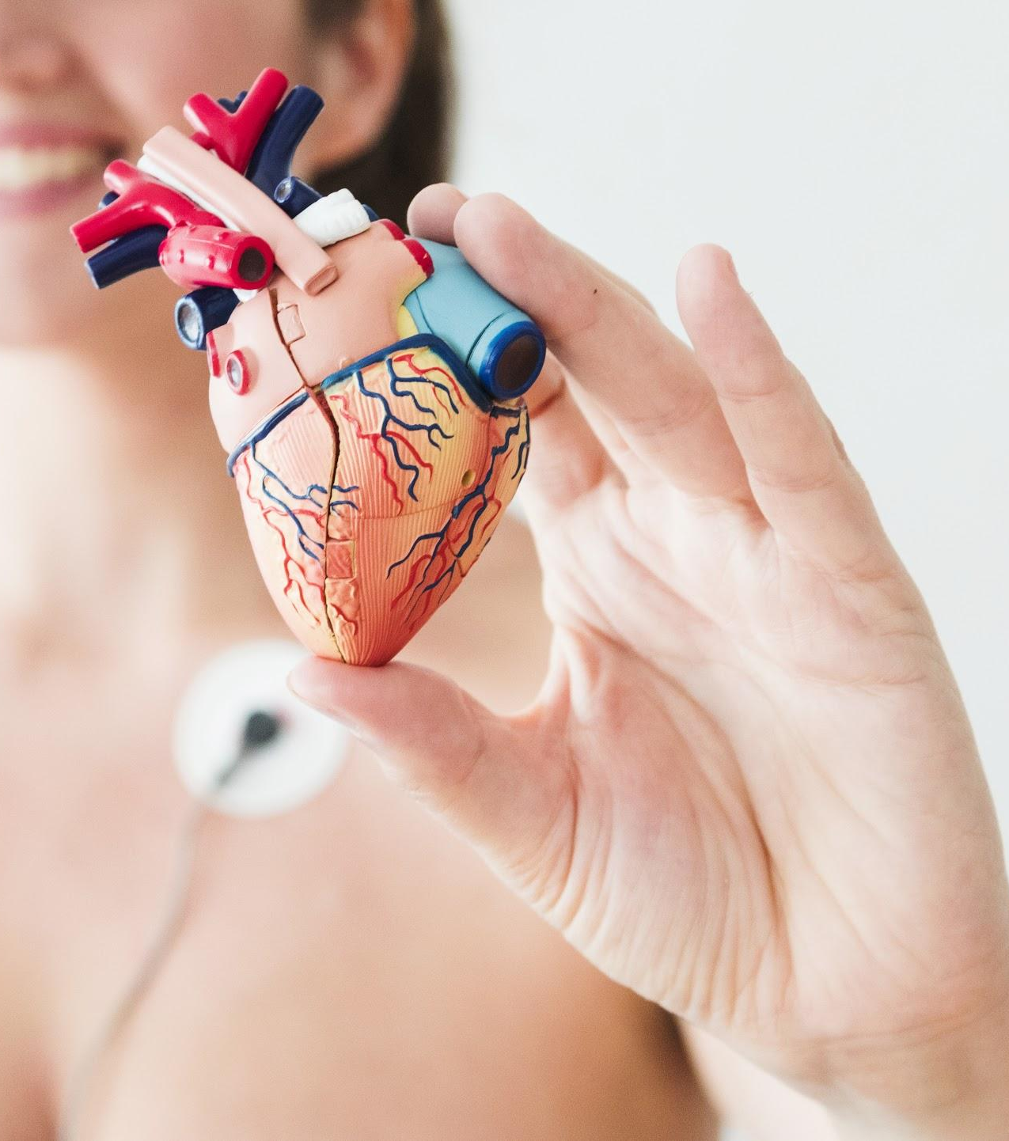
INTRODUCTION

Slide 6
IDENTIFYING INFORMATION
MARS
JUPITER
SATURN
Despite being red, Mars is actually a cold place full of iron oxide dust
It’s a gas giant and the biggest planet in the Solar System
Saturn is composed mostly of hydrogen and also helium

Slide 7
PATIENT MEDICAL HISTORY
2010
2012
2018
2019
Despite being red, Mars is actually a cold place
Mercury is the closest planet to the Sun
AGE | 62
GENDER | Male
ALLERGIES | None
LOCATION | Barcelona
Saturn is composed of hydrogen and helium
Jupiter is the biggest planet of them all

Slide 8
REVIEW OF SYSTEMS
Mercury is the closest planet to the Sun
Here you can list the symptoms observed in the patient
Here you can list the symptoms observed in the patient
Here you can list the symptoms observed in the patient
Here you can list the symptoms observed in the patient

Slide 9
PHYSICAL EXAMINATION
SATURN
MARS
JUPITER
Saturn is composed mostly of hydrogen and helium
Despite being red, this planet is actually a cold place
It’s a gas giant and the biggest planet in the Solar System

Slide 10
A PICTURE IS WORTH A THOUSAND WORDS

Slide 11
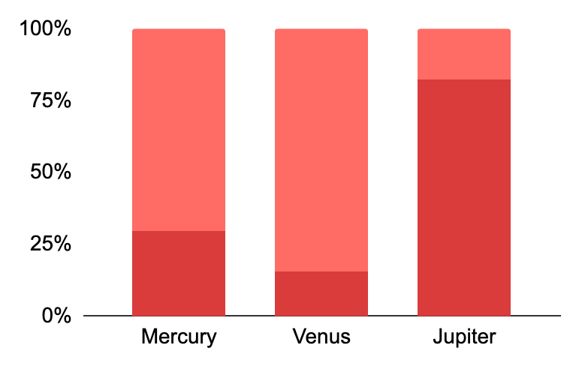
FINDINGS
33%
67%
Factor 1
Factor 2
Saturn is a gas giant and has several rings
Jupiter is the biggest planet in the Solar System
To modify this graph, click on it, follow the link, change the data and paste the resulting graph here

Slide 12
PREVALENCE
SATURN
MARS
VENUS
It’s a gas giant and has rings
It’s actually a cold place
This planet has a beautiful name

Slide 13
PERCENTAGES
60%
20%
20%
Saturn is a gas giant and has rings
Jupiter is the biggest planet of them all
Mars is full of iron oxide dust

Slide 14
8,987
Number of patients successfully treated last year

Slide 15
DISCUSSION
DR. JENNA DOE
DR. GUS McKANE
“Despite being red, Mars is a cold place. It’s full of iron oxide dust, which gives the planet its reddish cast”
“Neptune is the farthest planet from the Sun and the fourth-largest by diameter in the Solar System”

Slide 16
DISCUSSION SUMMARY
Mercury is the closest planet to the Sun and the smallest one in the Solar System—it’s only a bit larger than the Moon. The planet’s name has nothing to do with the liquid metal, since Mercury was named after the Roman messenger god

Slide 17
COMPARISON
 | JUPITER | MERCURY | VENUS | MARS
FACTOR 1
FACTOR 2
FACTOR 3

Slide 18
DIAGNOSIS
MERCURY
VENUS
MARS
JUPITER
SATURN
NEPTUNE
Mercury is the closest planet to the Sun
Venus is the second planet from the Sun
Despite being red, Mars is actually a cold place
Jupiter is the biggest planet of them all
It’s composed mostly of hydrogen and helium
Neptune is the farthest
planet from the Sun

Slide 19
TREATMENT
MERCURY
MARS
SATURN
NEPTUNE
Mercury is the closest planet
to the Sun
Despite being red, Mars is actually a cold place
It’s composed mostly of hydrogen and helium
Neptune is the farthest planet from the Sun

Slide 20
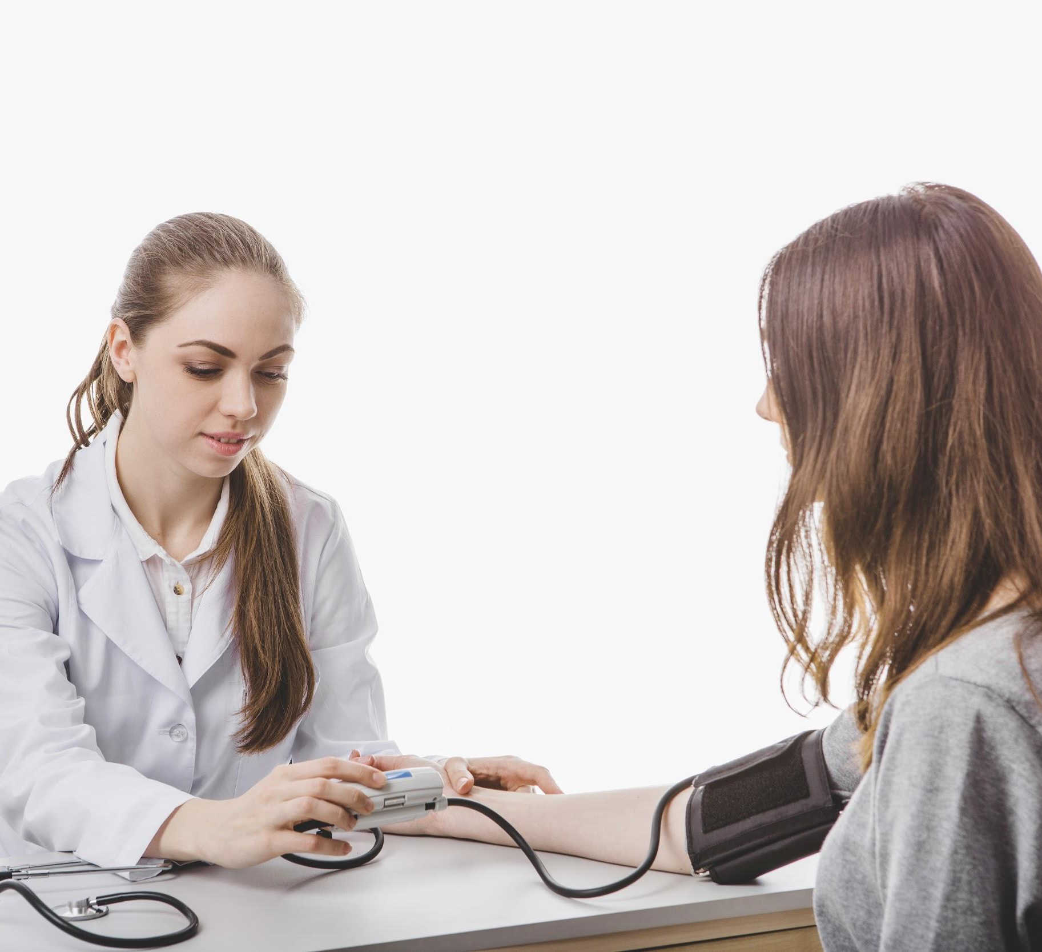
PATIENT MONITORING
33%
20%
47%
Venus has a beautiful name
Saturn is the ringed one
Despite being red, Mars is cold
Week 1
Week 2
Week 3

Slide 21
CONTRAINDICATIONS AND INDICATIONS
WHY YOU SHOULD STOP THE TREATMENT
WHY YOU SHOULD START THE TREATMENT
Here you can describe a reason to stop the treatment
Here you can describe a reason to stop the treatment
Here you can describe a reason to stop the treatment
Here you can describe a reason to stop the treatment
Here you can describe a reason to start the treatment
Here you can describe a reason to start the treatment
Here you can describe a reason to start the treatment
Here you can describe a reason to start the treatment

Slide 22
POST-PREVENTION
MARS
NEPTUNE
VENUS
MERCURY
Despite being red, Mars is actually a cold place
Neptune is the farthest planet from the Sun
Venus is the second planet from the Sun
Mercury is the closest planet to the Sun

Slide 23
CASE TIMELINE
WEEK 1
WEEK 3
WEEK 2
WEEK 4
Venus has a beautiful name
Jupiter is the biggest planet
Mars is full of iron oxide dust
Pluto is a dwarf planet

Slide 24
CONCLUSIONS
Jupiter is a gas giant, the biggest planet in the Solar System and the fourth-brightest object in the night sky. It’s named after the Roman god of the skies and lightning. It’s composed mainly of hydrogen and helium

Slide 25
REFERENCES
AUTHOR (YEAR). Title of the publication. Publisher
AUTHOR (YEAR). Title of the publication. Publisher
AUTHOR (YEAR). Title of the publication. Publisher
AUTHOR (YEAR). Title of the publication. Publisher
AUTHOR (YEAR). Title of the publication. Publisher
AUTHOR (YEAR). Title of the publication. Publisher

Slide 26
OUR TEAM
JOHN JAMES
JANE DOE
Add pictures of your team
You can replace these images

Slide 27
ALTERNATIVE RESOURCES
Female doctor holding a plush heart and a stethoscope
Portrait of charming young man standing against on white background
Young doctor measuring tension to a patient
Male doctor hands measuring tension to a patient
Person showing decorative vinous heart
Doctor presenting plastic heart
Heart with cross near stethoscope and medications
Doctor checking patient with stethoscope
Hand holding stethoscope
Tired female doctor taking out her glasses

Slide 28
RESOURCES
Did you like the resources on this template? Get them for free at our other websites
PHOTOS:
Medium shot doctor with her arms crossed
Woman with electrodes holding figurine of heart
Doctor hands holding plush heart
Female doctor hands holding a stethoscope
Close-up of a doctor filling the medical form with patient
Happy elder man photography portrai
Woman medic making tension exam to patient
Crop hands of male patient and doctor on table
Handsome doctor measuring tension to female patient
Hands holding heart
Doctor's hands working with tablet
Surgeon with a heart
VECTORS:
Medical infography

